Slide 1
HERO SOCIAL NETWORK ANALYSIS
The Marvel Universe is an inter-connected network in the story verse much like a present-day social network. The heroes have their own stories/groups and collaborate to save the universe as a community, much like people do in real life.
We analyze this network social networks by examining the relationships between different characters to learn more about real world social networks.

Slide 2
Meet the Team and their favorite characters
ABHINANDAN VERMA | IRON MAN
AMANDA WEI | WANDA
CK ANAND PRAKASH | THOR
DEYN LI | BATMAN
KINGSLEY LIU | CAPTAIN AMERICA
URVI VAIDYA | AGENT COULSON

Slide 3
6421
Our Network Stats
20,611,410
167112
Size of Network
No of Possible Edges
No of Edges
52.05
5
2.635
0.008
Avg. Degree
Network Diameter
Geodesic distance a.k.a
Density of Network
Avg. Path Length

Slide 4
SOMETIMES, REVIEWING CONCEPTS IS A GOOD IDEA
DEGREE
BETWEENESS
How many ties does a node have.
How much is a node needed to broker an exchange.
CLOSENESS
NO OF TRIANGLES
How quickly can a node interact with all others.
How many small cliques are formed by this node.
EIGENVECTOR
MODULARITY CLASS
Importance of nodes based on its own centrality and that of its connections.
Groups of Nodes that are closely tied to one another

Slide 5
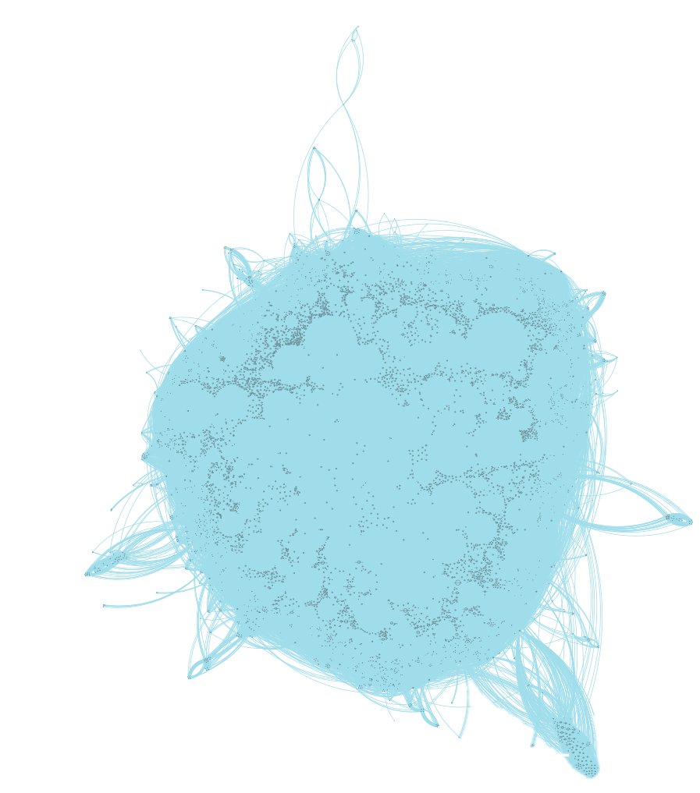
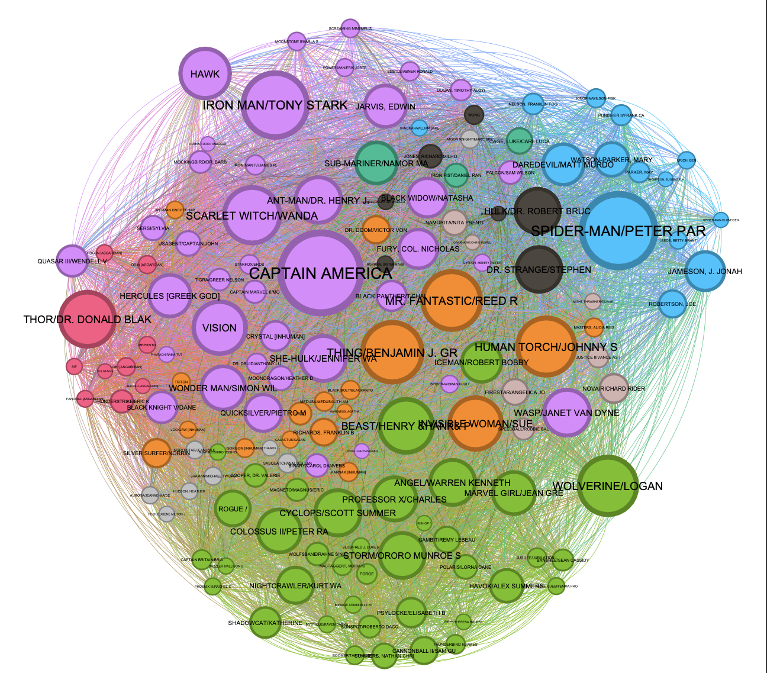
Finally the Graphs
Our Network in Entirety
Filtered Network with Degree & Modularity

Slide 6
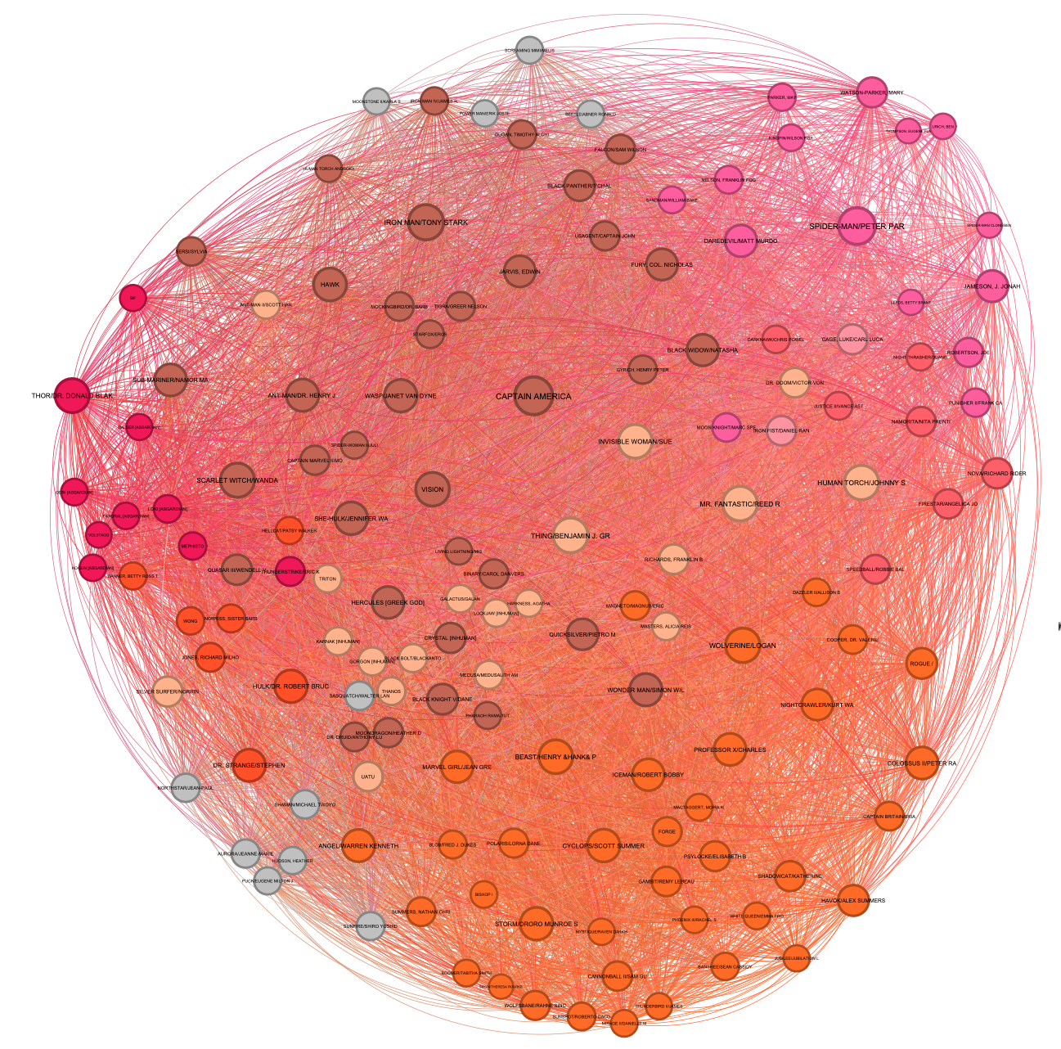
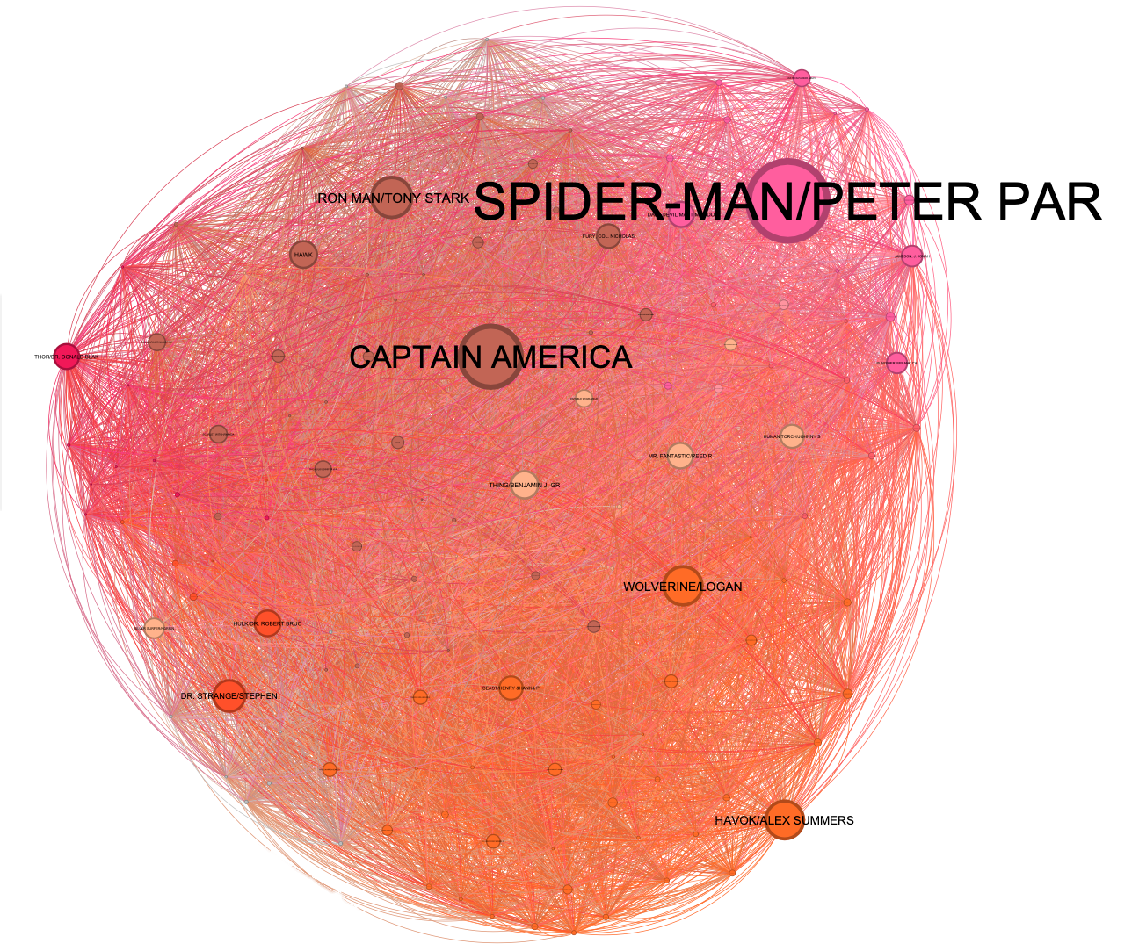
Centralities
Closeness with Modularity
Betweenness with Modularity

Slide 7
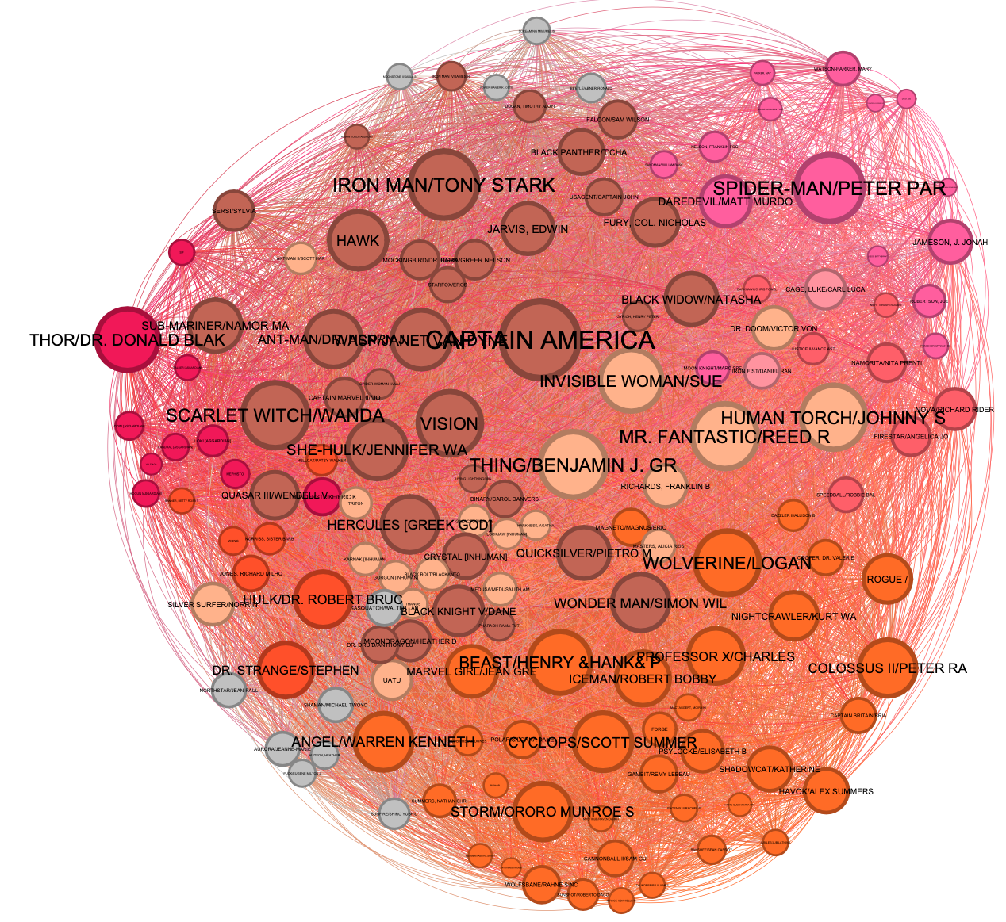
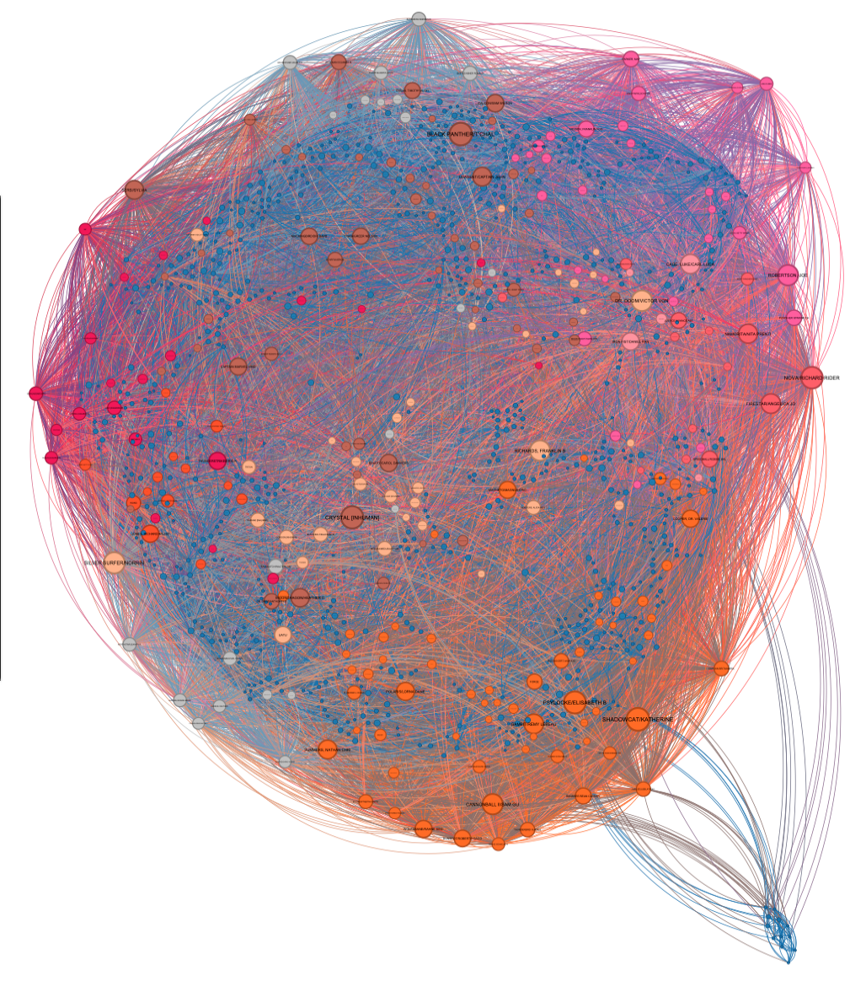
Centralities
Eigenvector with Modularity
Degree of the Middle Range with Modularity

Slide 8
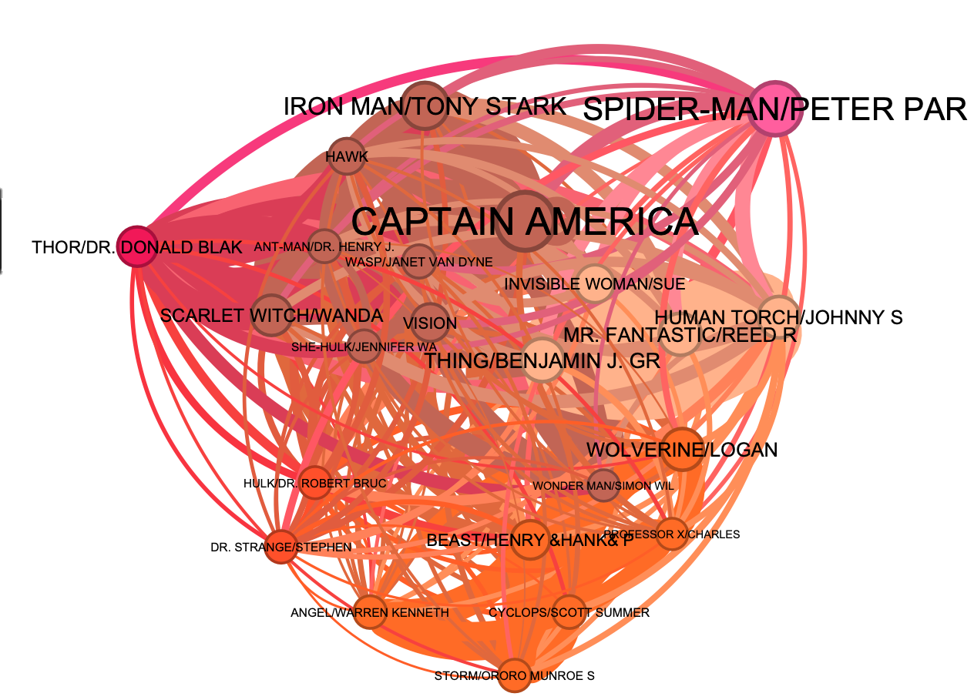
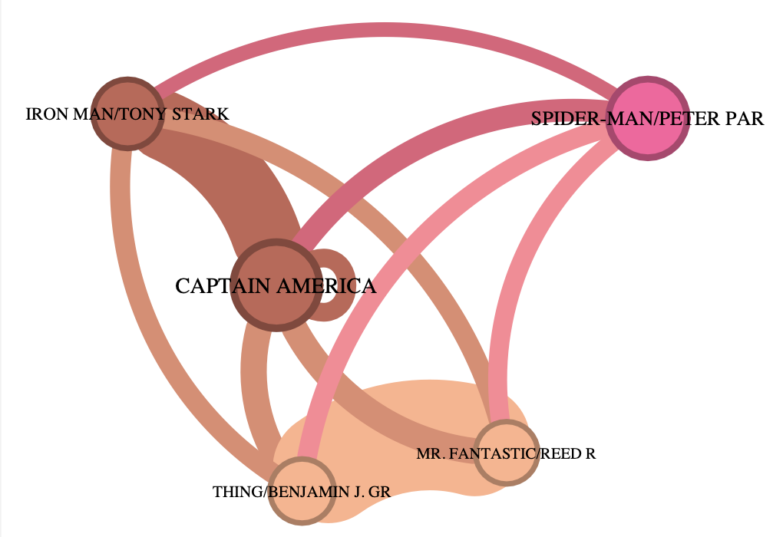
Network of Popular Characters
Network of the Top 25 Characters
Network of the top 5 characters

Slide 9
Lets talk Numbers
 | DEGREE | BETWEENESS | CLOSENESS | EIGENVECTOR | CLUSTERING COEFFICIENT | NO OF TRIANGLES
CAPTAIN AMERICA | 1905 | 1173071.86 | 0.5852 | 1.0 | 0.0490 | 88849
SPIDERMAN | 1737 | 1516223.61 | 0.5757 | 0.8711 | 0.0488 | 73690
IRON MAN | 1521 | 767294.35 | 0.5630 | 0.8718 | 0.0620 | 71764
THING | 1416 | 524521.76 | 0.5594 | 0.8541 | 0.0691 | 69252

Slide 10
Meet our Influencers / Hubs
CAPTAIN AMERICA a.k.a.
Steven Rogers
SPIDERMAN a.k.a.
Peter Parker
IRON MAN a.k.a. Tony Stark
Highest Degree, Eigenvector &
No of Triangles
Originally Introduced in 1941
Member of the Avengers, Secret Avengers, All-Winners Squad, Redeemers, Invaders
Highest Betweenness Originally Introduced in 1962
Member of Avengers and allies with Ironman, Captain America, Doctor Strange & Star Lord,
Second Highest Eigenvector
Originally Introduced in 1963
Member of the Avengers, Initiative, Hellfire Club, S.H.I.E.L.D, Illuminati, Thunderbolts, Force Works & Queen’s Vengeance

Slide 11
CONCLUSION
It’s a small world out there - With an avg. clustering coefficient of 0.781 , network diameter of 5 and avg. path length of 2.638, its just a few links to get from one node to another.
With great power comes great responsibility - A few nodes have the most links and there is a long tail of nodes with very few links. Our top 4 heroes are the centers of 4 large hubs, so, if danger comes calling and the world is facing impending doom you can save a lot of time and energy by contacting these 4 people first. Assembling the Avengers has never been easier.
Network analysis can help identify essential characters, inform plot development, and inform marketing strategies in the MCU. It can also be applied to analyze audience engagement and identify key influencers for marketing and business strategies related to the franchise.

Slide 12
THANKS

